Slide 1
Interim 2

Slide 2
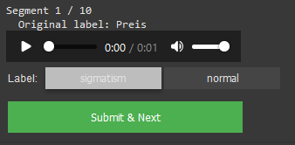
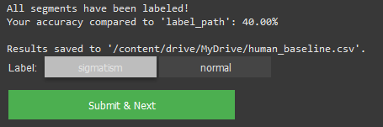
Human Baseline
468 words
All data is saved in a csv for later analysis

Slide 3
Sabine
Total:468, Correct: 270, False: 198, Accuracy: 57,69%
-> everything saved in a csv
Words with s in the end where hard (some kind of cutoff/ended to fast)
Score excluding ‘s‘,‘z‘-ending-words: 57,31%

Slide 4
Dataset
61 Speaker
61 sigmatism Recordings
61 normal Recordings
57 qualified
4 removed
Assessment by speech therapist
Number of speakers in train: 48, val: 9 test: 4

Slide 5
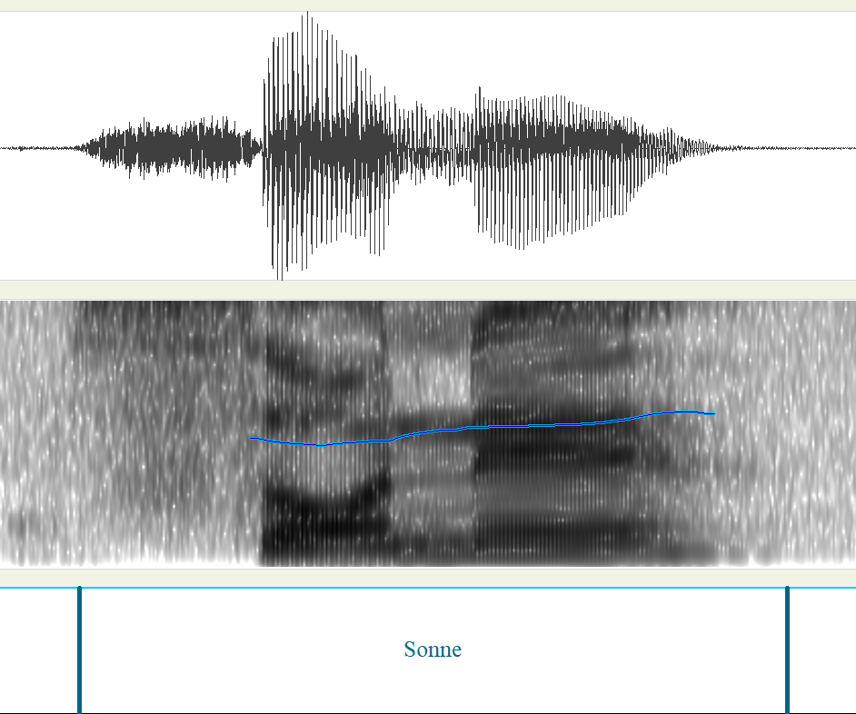
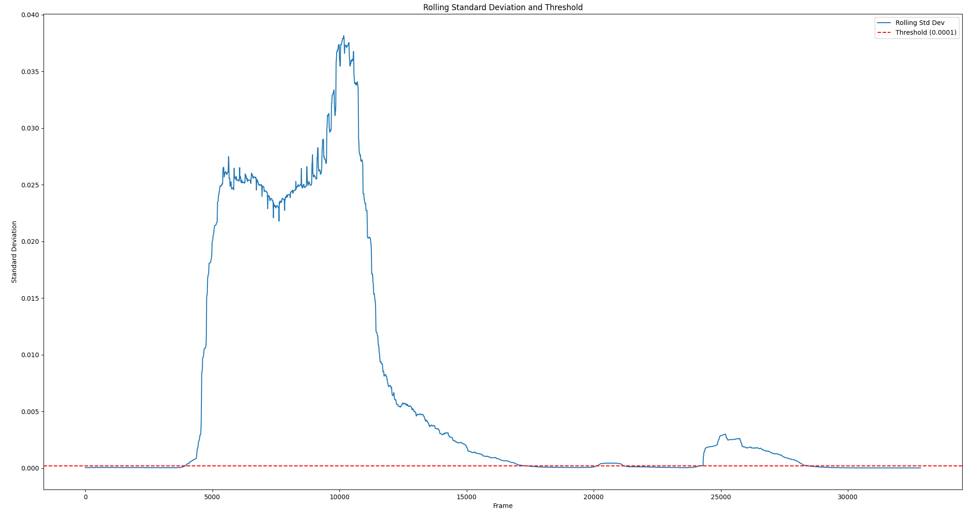
Audio Extraction
Webmouse labels used for rough guidance
Rolling std peformed whith threshold at 0.0002

Slide 6
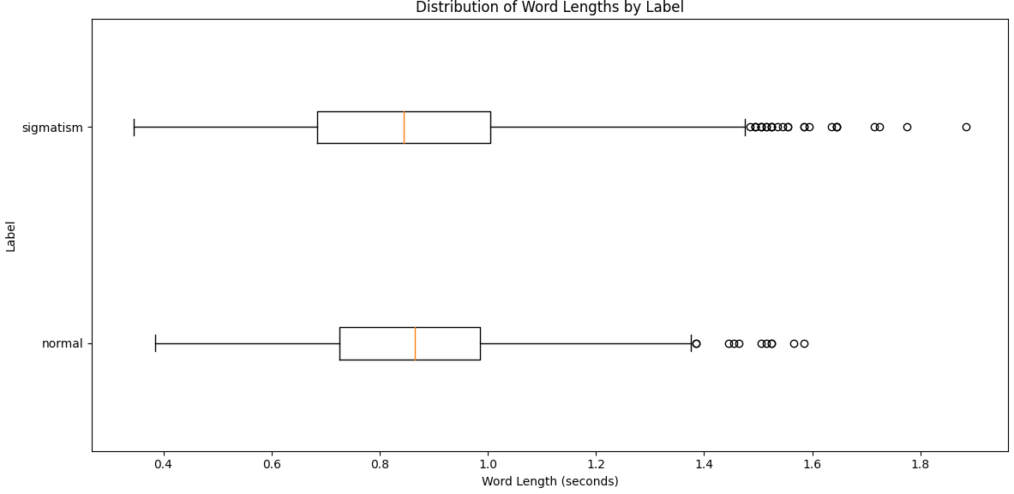
New length of words
Notes:
Man könnte sich noch einen low pass filter überlegen.
Outlier ab 1.5 mal angeschaut. Sind fast alles sigmatismus wörter. Aussprache teilweise sehr betont.

Slide 7
Normalization
Till now [-1,1] (Peak) Normalization but has some flaws
Use Mean-and-Variance Normalization per speaker (z-score)
Got global mean and std from training split
Applied that to each wav file for CPP,FAD.
- For MFCC and Mel specto, STT-CNN:
Normalize only image with z-score. Avoid double normalization?
The STT takes the raw waveform
Notes:
[-1,1] (Peak) Normalization doesn not stabilize mean and variance
limiting to [−1,1] helps avoid clipping in fixed-point systems. But in deep learning it’s fine to have values outside [−1,1]
Potentially Harms Gradient Descent

Slide 8
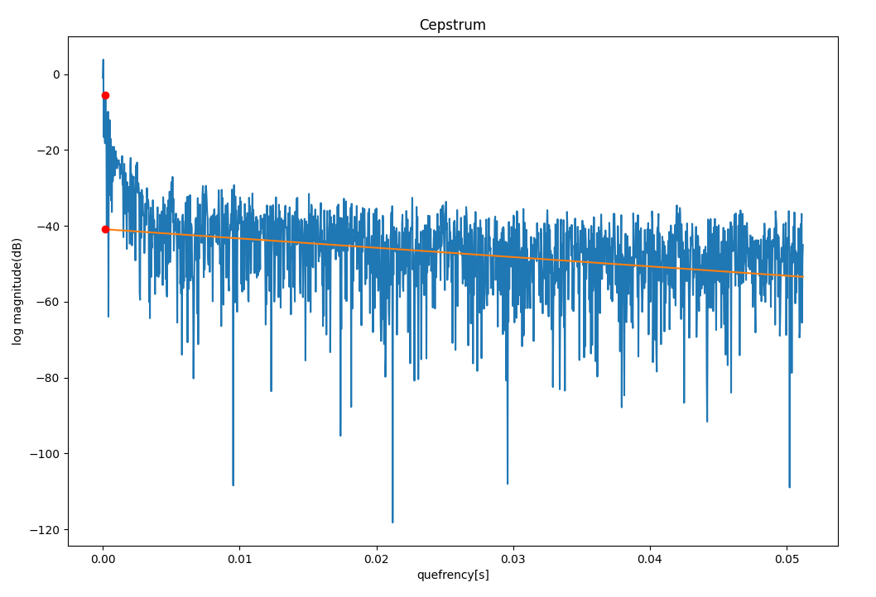
CPP – 16kHz
trendline_quefrency_range=[0.001, 0.05]
Notes:
taking the log magnitude of a signal’s Fourier transform and then performing an inverse Fourier transform on that log spectrum.
its horizontal axis is sometimes called quefrency
If your speech signal has a strong fundamental frequency F0F_0F0​ (pitch), the cepstrum will typically show a peak at the quefrency τ0=1/F0\tau_0 = 1 / F_0τ0​=1/F0​.

Slide 9
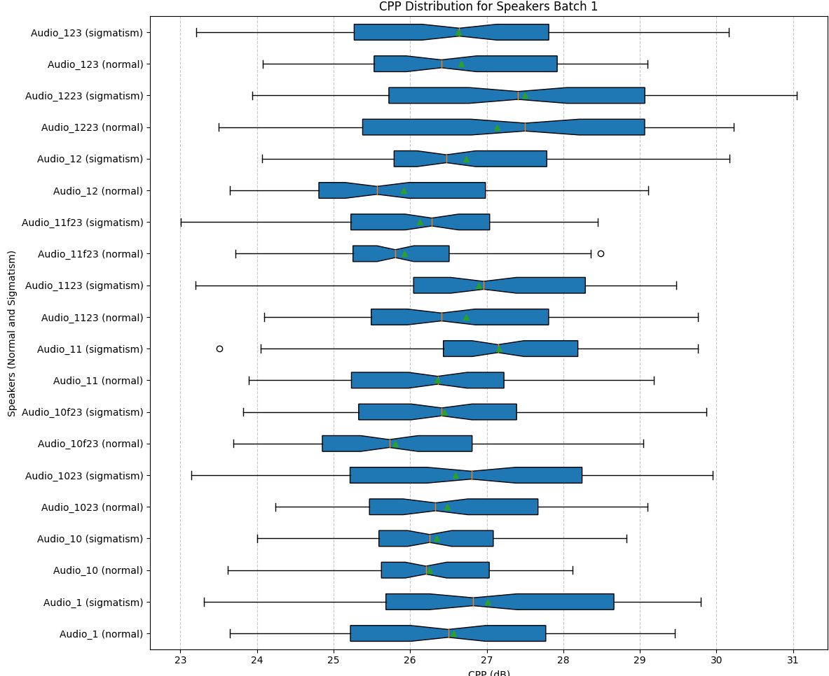
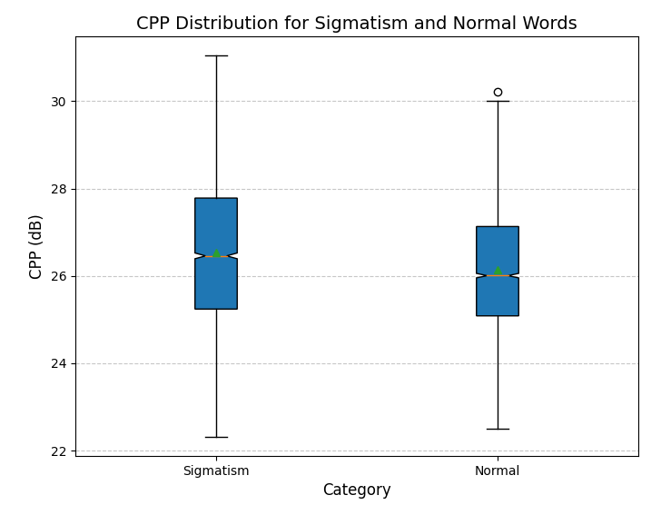
pitch_range=[60, 1000]HZ,
Notes:
the trendline quefrency range is the range of the cepstrum over which you fit a linear regression (or trend line) to model the overall slope of the cepstrum.

Slide 10
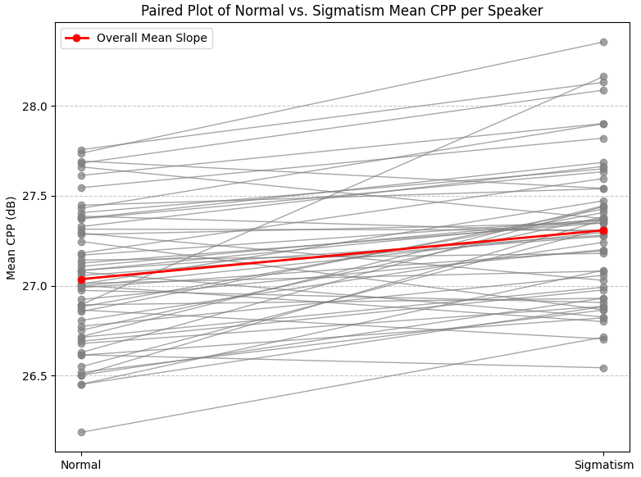
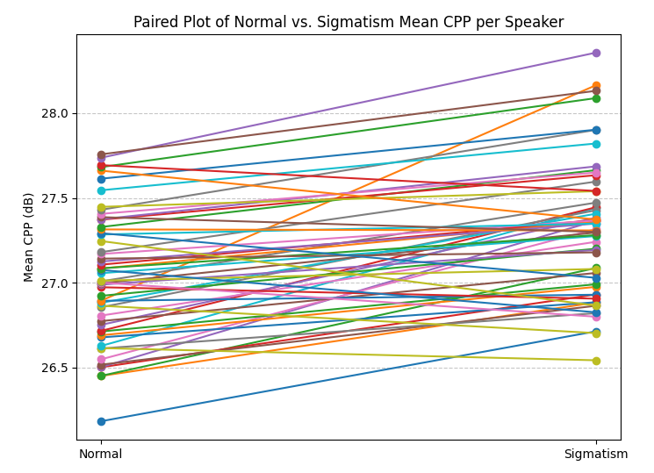
Paired T-test
pitch_range=[60, 1000],

Slide 11
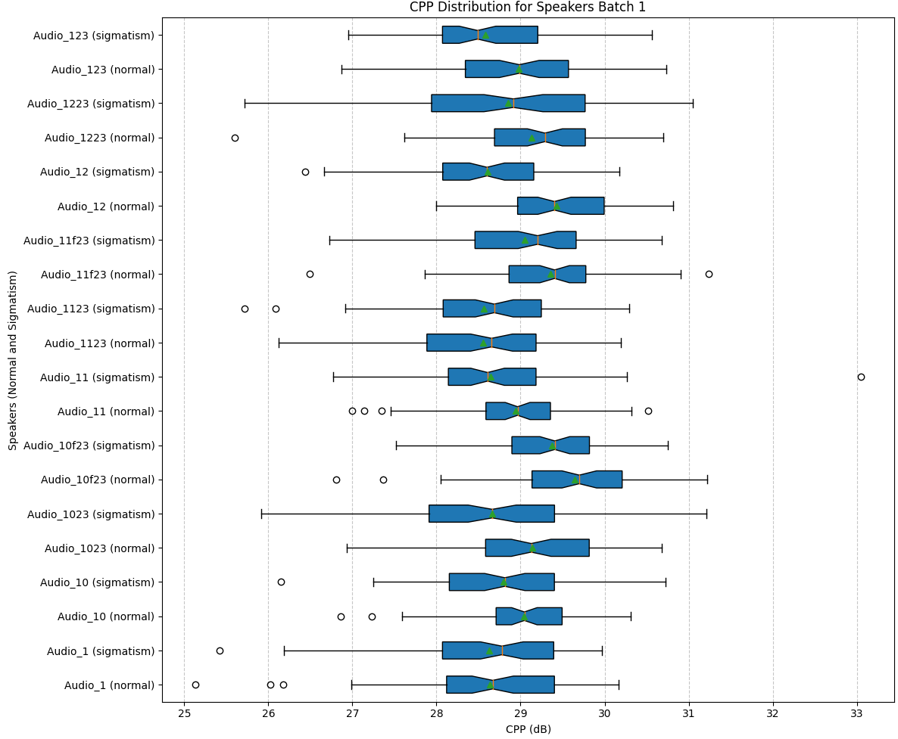
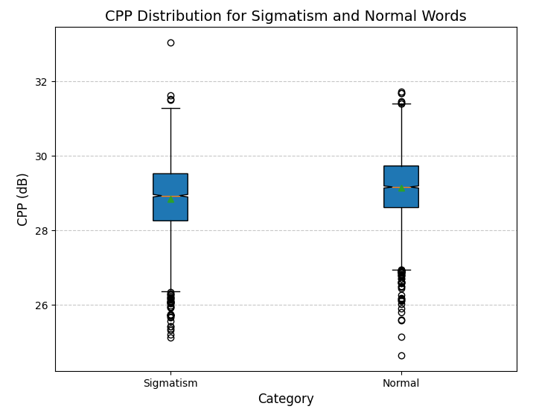
pitch_range=[60, 8000],

Slide 12
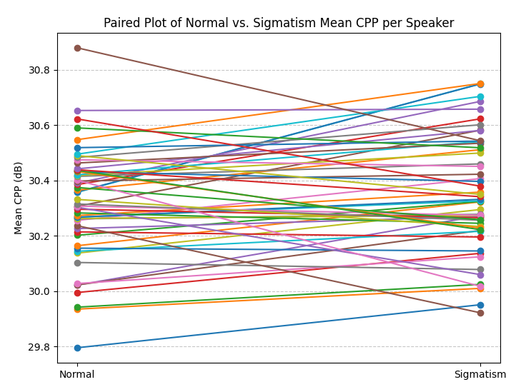
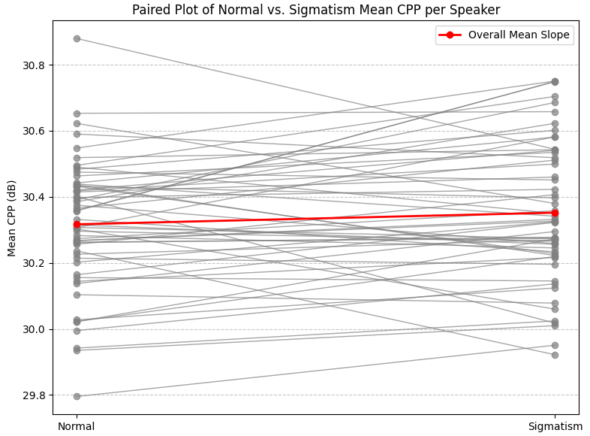
Paired T-test
pitch_range=[60, 8000],

Slide 13
FID/FAD
The FAD model is the same as before because it takes the raw audio folder: FAD score with model: 0.278
Compute mean and cov
FID = ||mu1 - mu2||^2 + Tr(sigma1 + sigma2 - 2 * sqrt(sigma1 * sigma2))
mu1, sigma1 : Mean vector and covariance of word 1
mu2, sigma2 : Mean vector and covariance of word 2
Was done for every word because cov otherwise too big.

Slide 14
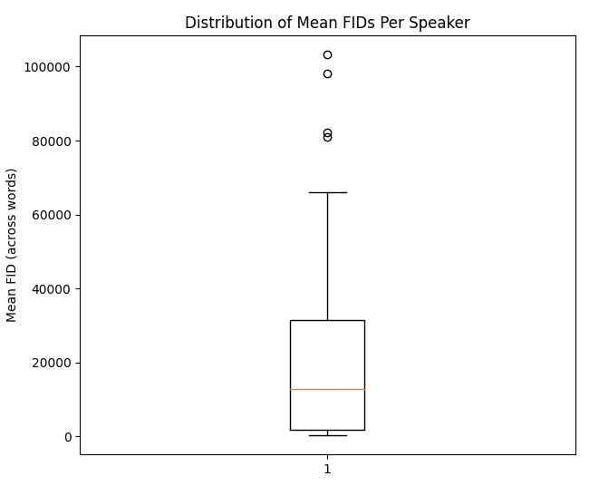
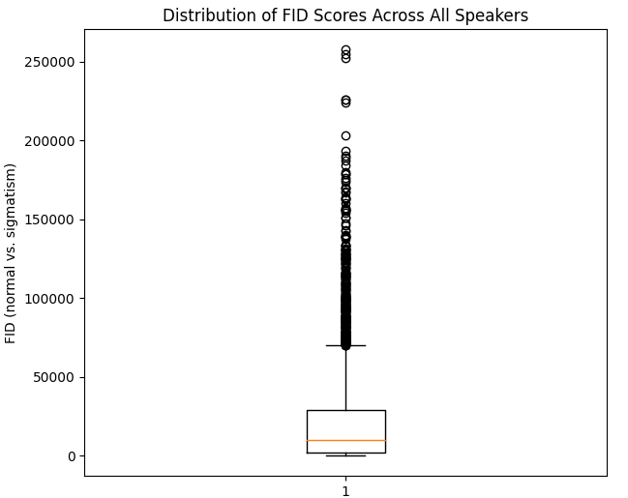
Notes:
FAD auch noch machen für
Sonne zu sonne normal ist 0
Sonne zu sonne sigmatismus is da oben
Jetzt sonne sigmatismus oder normal zu veralssen normal oder sig
Vom gleichen speaker sonne zu sonne normal

Slide 15
STT model
16kHz non normalized word segments used
ß was changed to s
Only if s,x or z are present in a word the AuC is computed

Slide 16
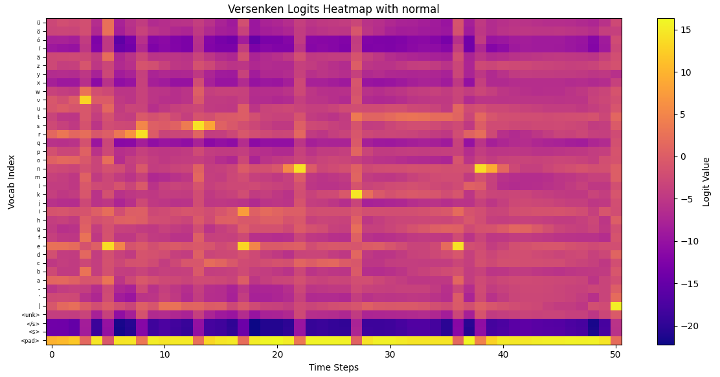
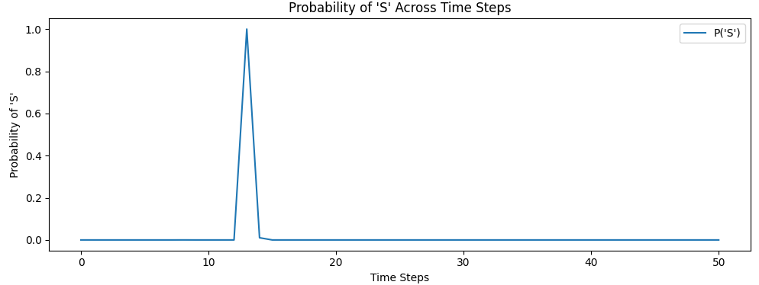
Reference: Versenken
Prediction: ['versenken’]
normal

Slide 17
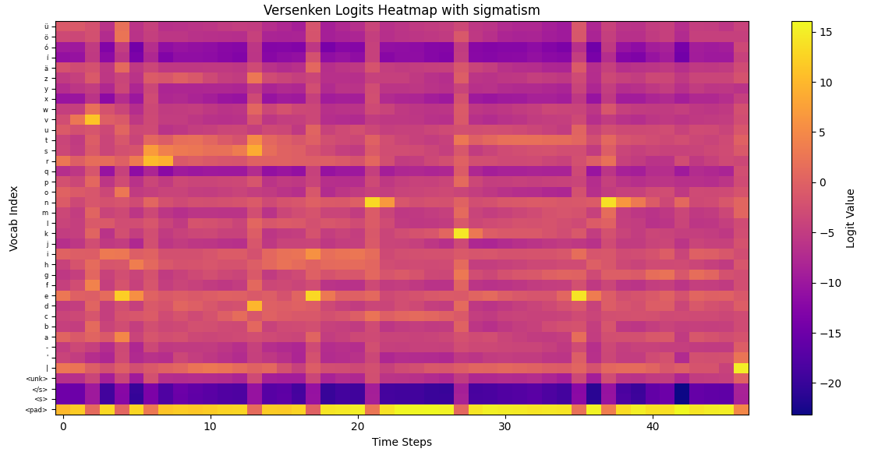
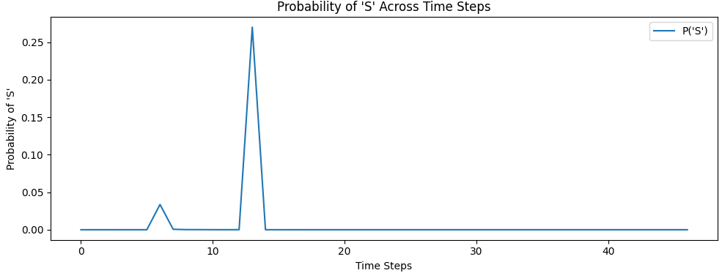
Reference: Versenken
Prediction: ['verdenken’]
sigmatism

Slide 18
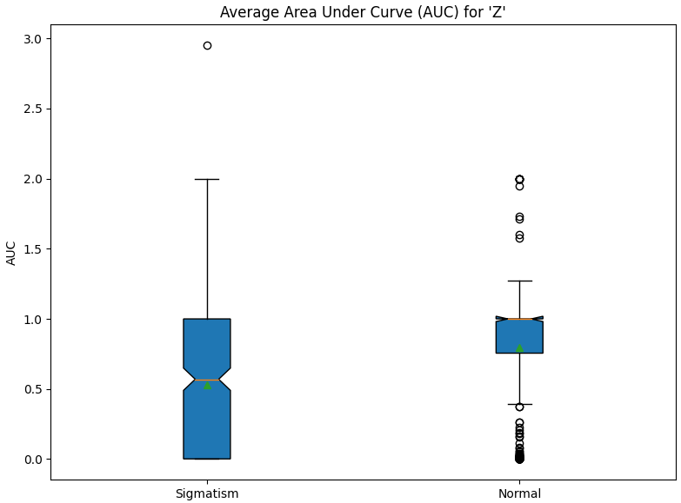
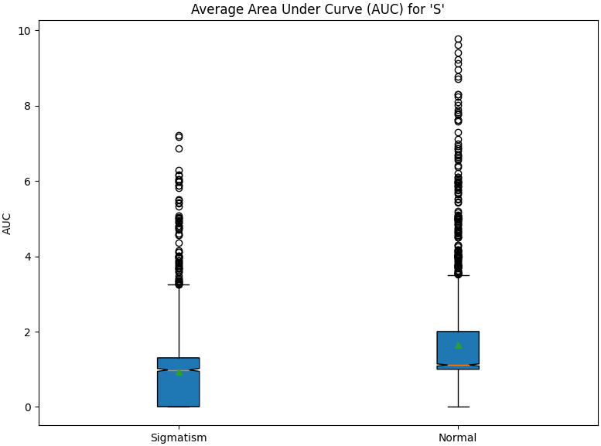
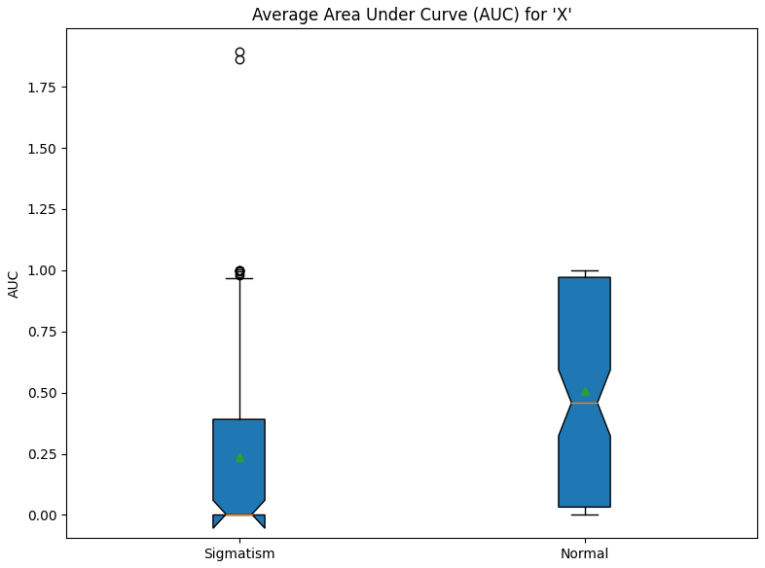
Notes:
Das gleiche machen nur das man sich den ausschnitt von dem wort wo das s ist an und machen nur da AuC
Dann slice in time domain anschaue und übereinanderlegen.
Logistic regression machen dazu machen auf die biomodale verteilung
17.Februar interspeech

Slide 19
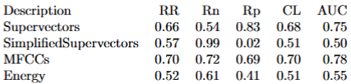
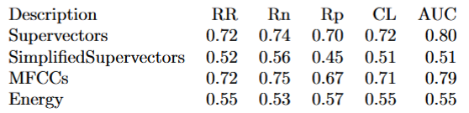
Valentini Paper – On the big dataset
SVM used for calssification
AdaBoost used for calssification

Slide 20
Next Steps:
Hyperparamtuning for MFCC, Mel-Specto, Attention 1 &2
How to make fixed lists? How often what and how many times augmented?
Should i do random Crop/pad on audio?
Should i do any augmentations on the images?
Hyperparam training for STT approach.
Only take rows of s,x,z? -> small input?
Any augmentations?
How to resize?
First pad till longest word in time axis. Then interpolate in both axis.
Do that for STT, MFCC, Mel Specto?
Notes:
Noise
Time strecht
Pitch shifting
Crop /pad

Slide 21
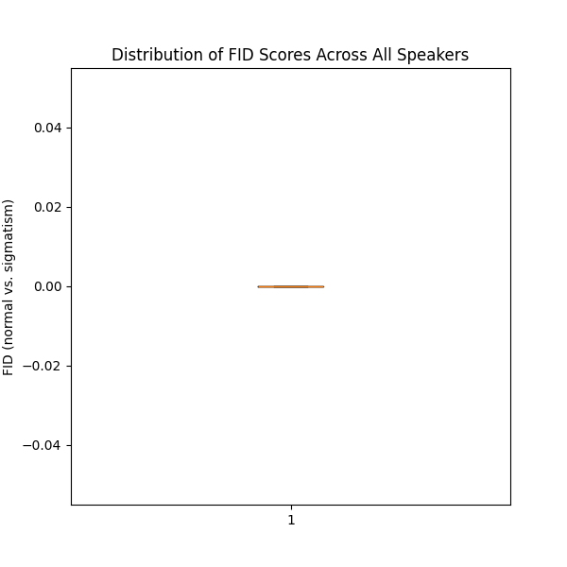
Wort n zu sich selbst

Slide 22
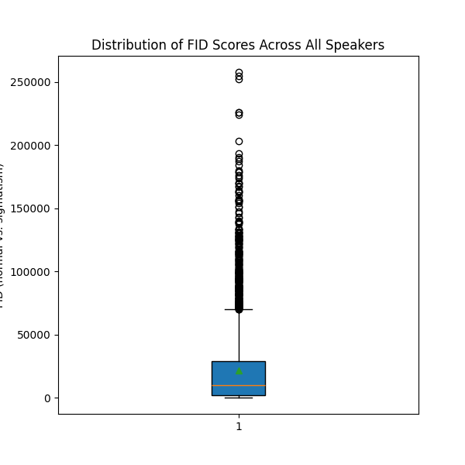
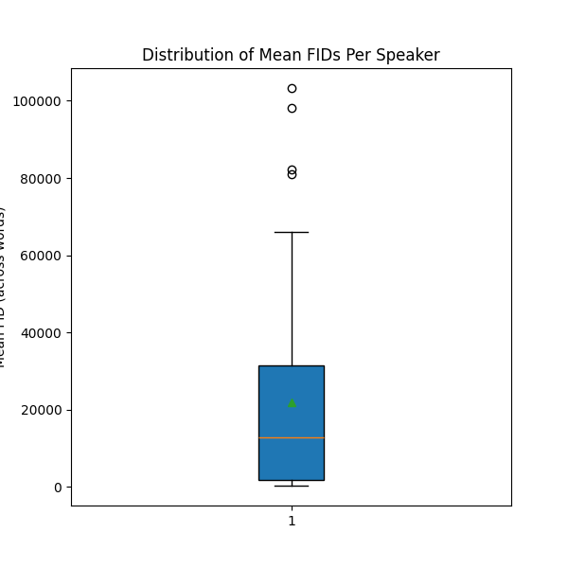
Wort n zu gleichem wort s

Slide 23
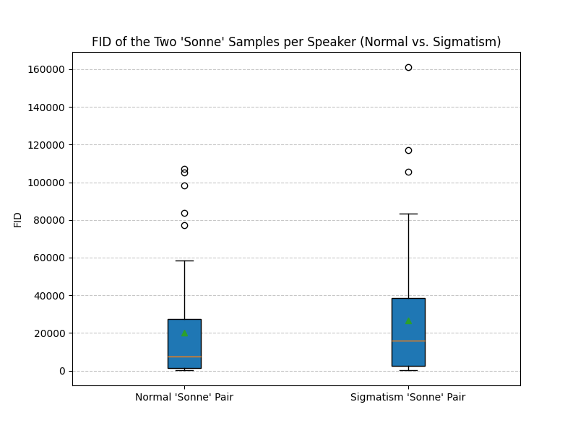
Gleicher speaker sonne n zu sonne n

Slide 24
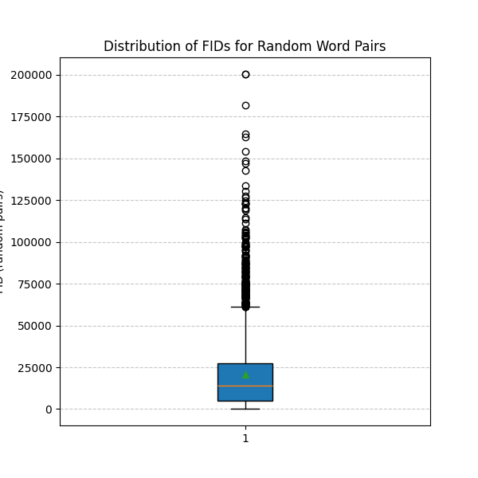
Wort zu anderem wort

Slide 26
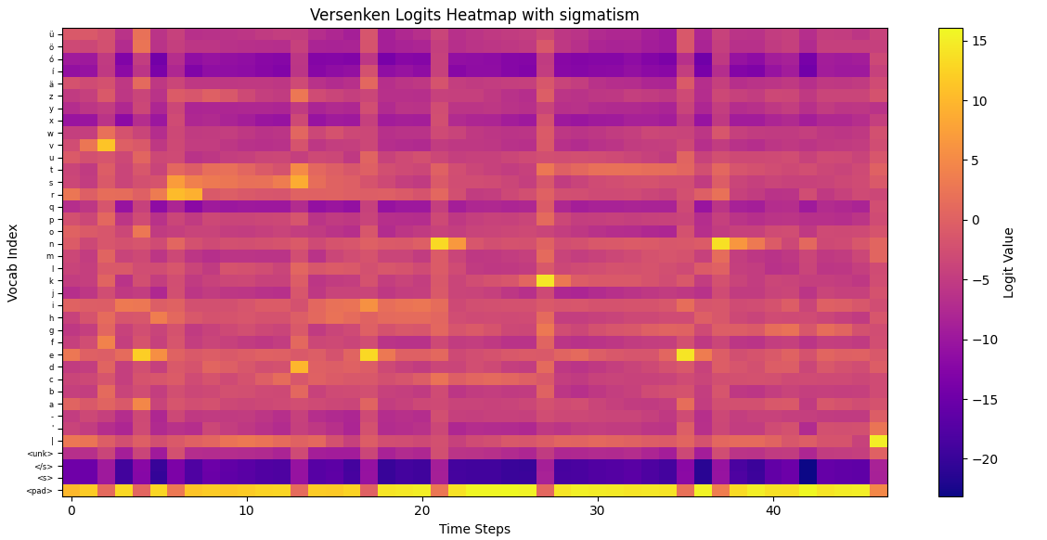
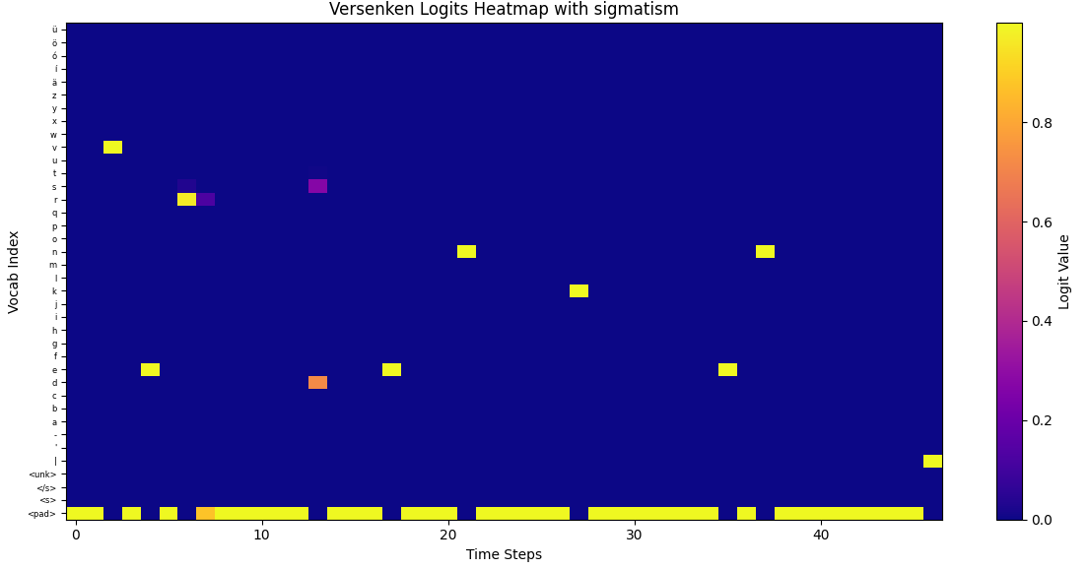
STT
Softmax along vocab dimension

Slide 27
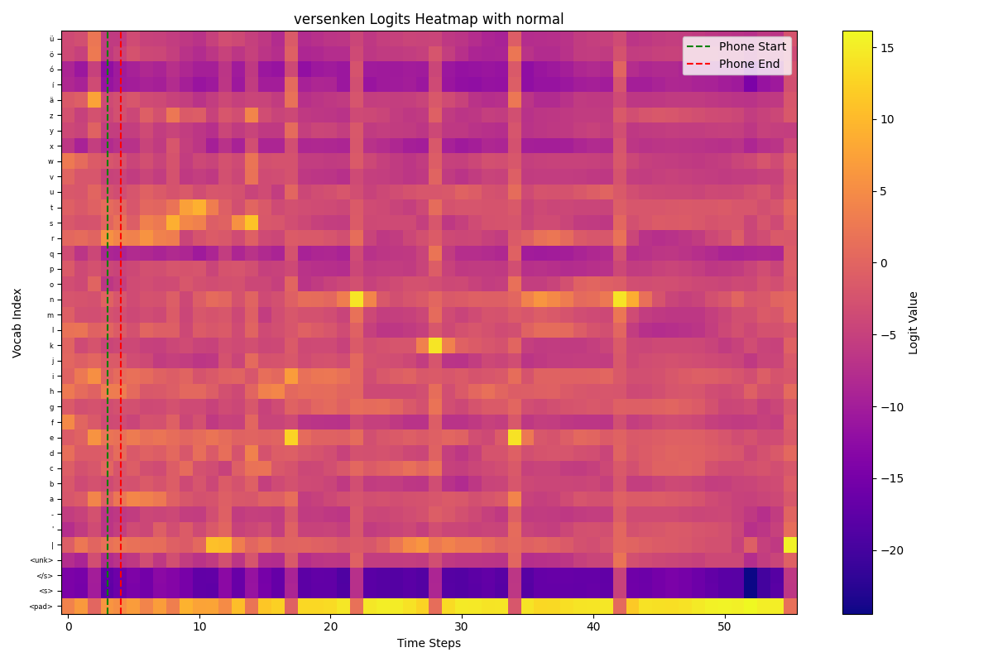
STT – Approach 1
Got phone segments from webmouse

Slide 28
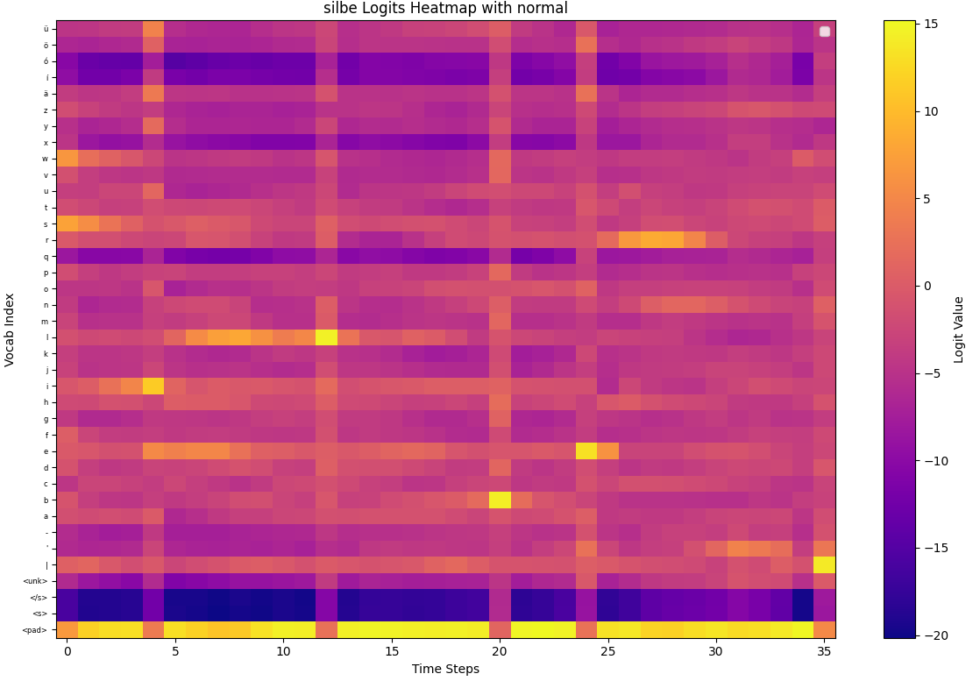
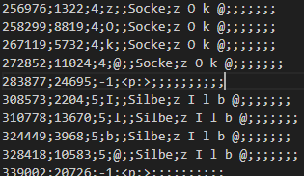
STT – Approach 1 – Problems:
Webmouse failed labeling the phones

Slide 29
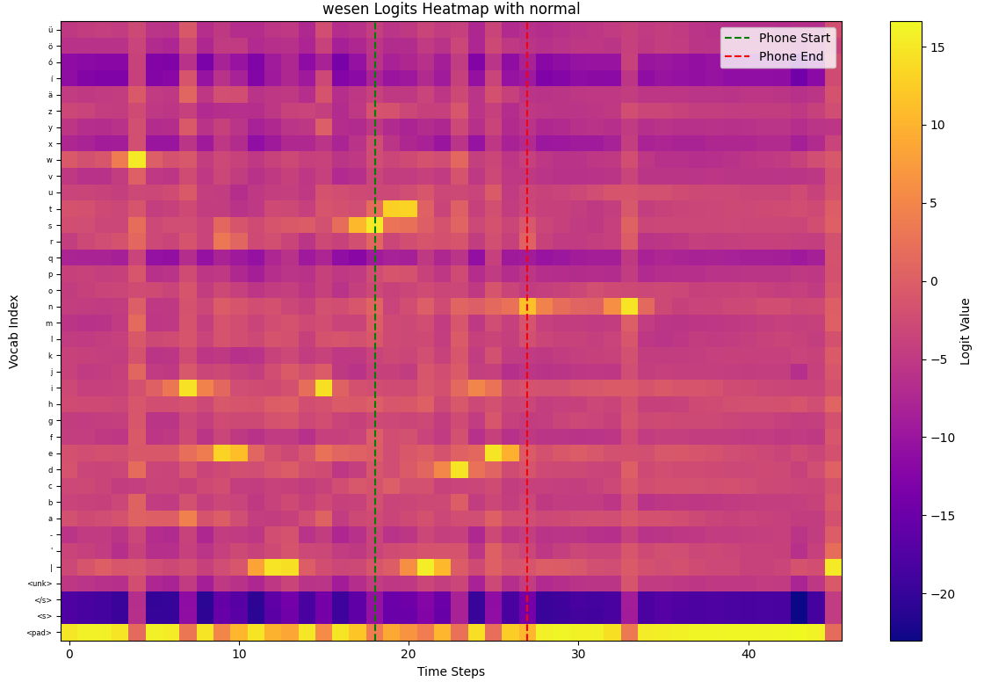
STT – Approach 2 – Attention relative
Weighted by the relative number of chars in the word
SCH and ST and not taken

Slide 30
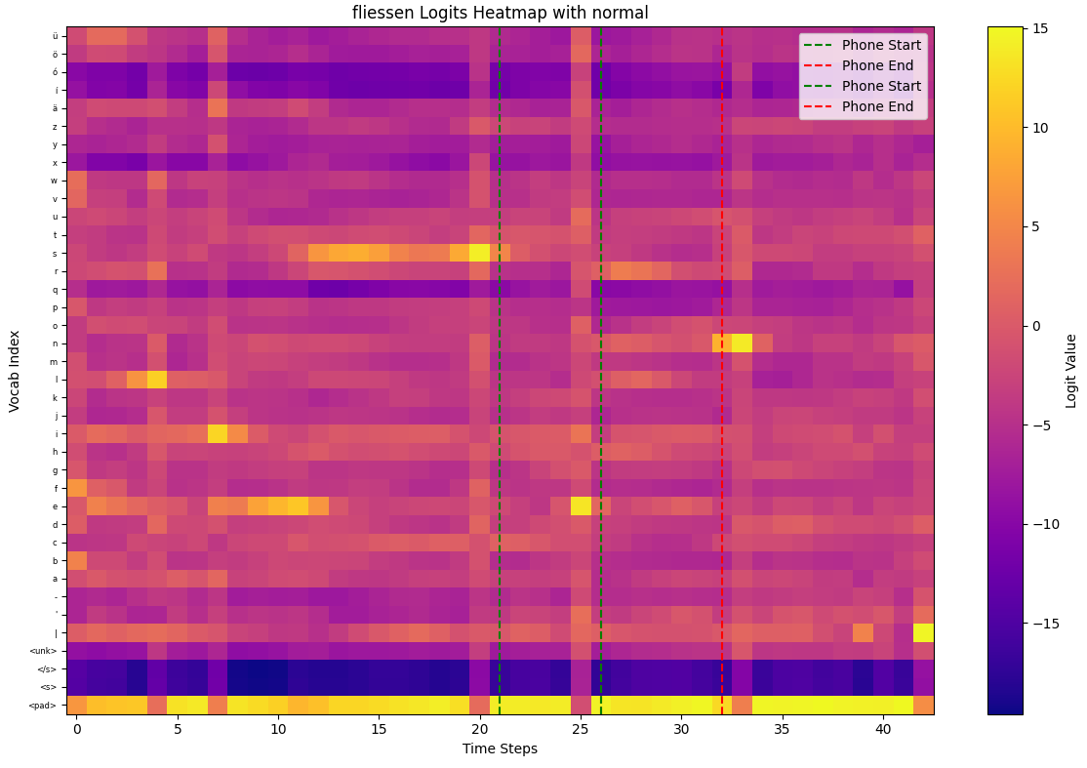
STT – Approach 2 – Problems
Often doesn‘t get right part because of forced alignment

Slide 31
Bimodal view

Slide 32
Training on heatmap.

